Slide 1
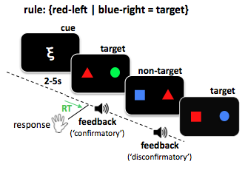
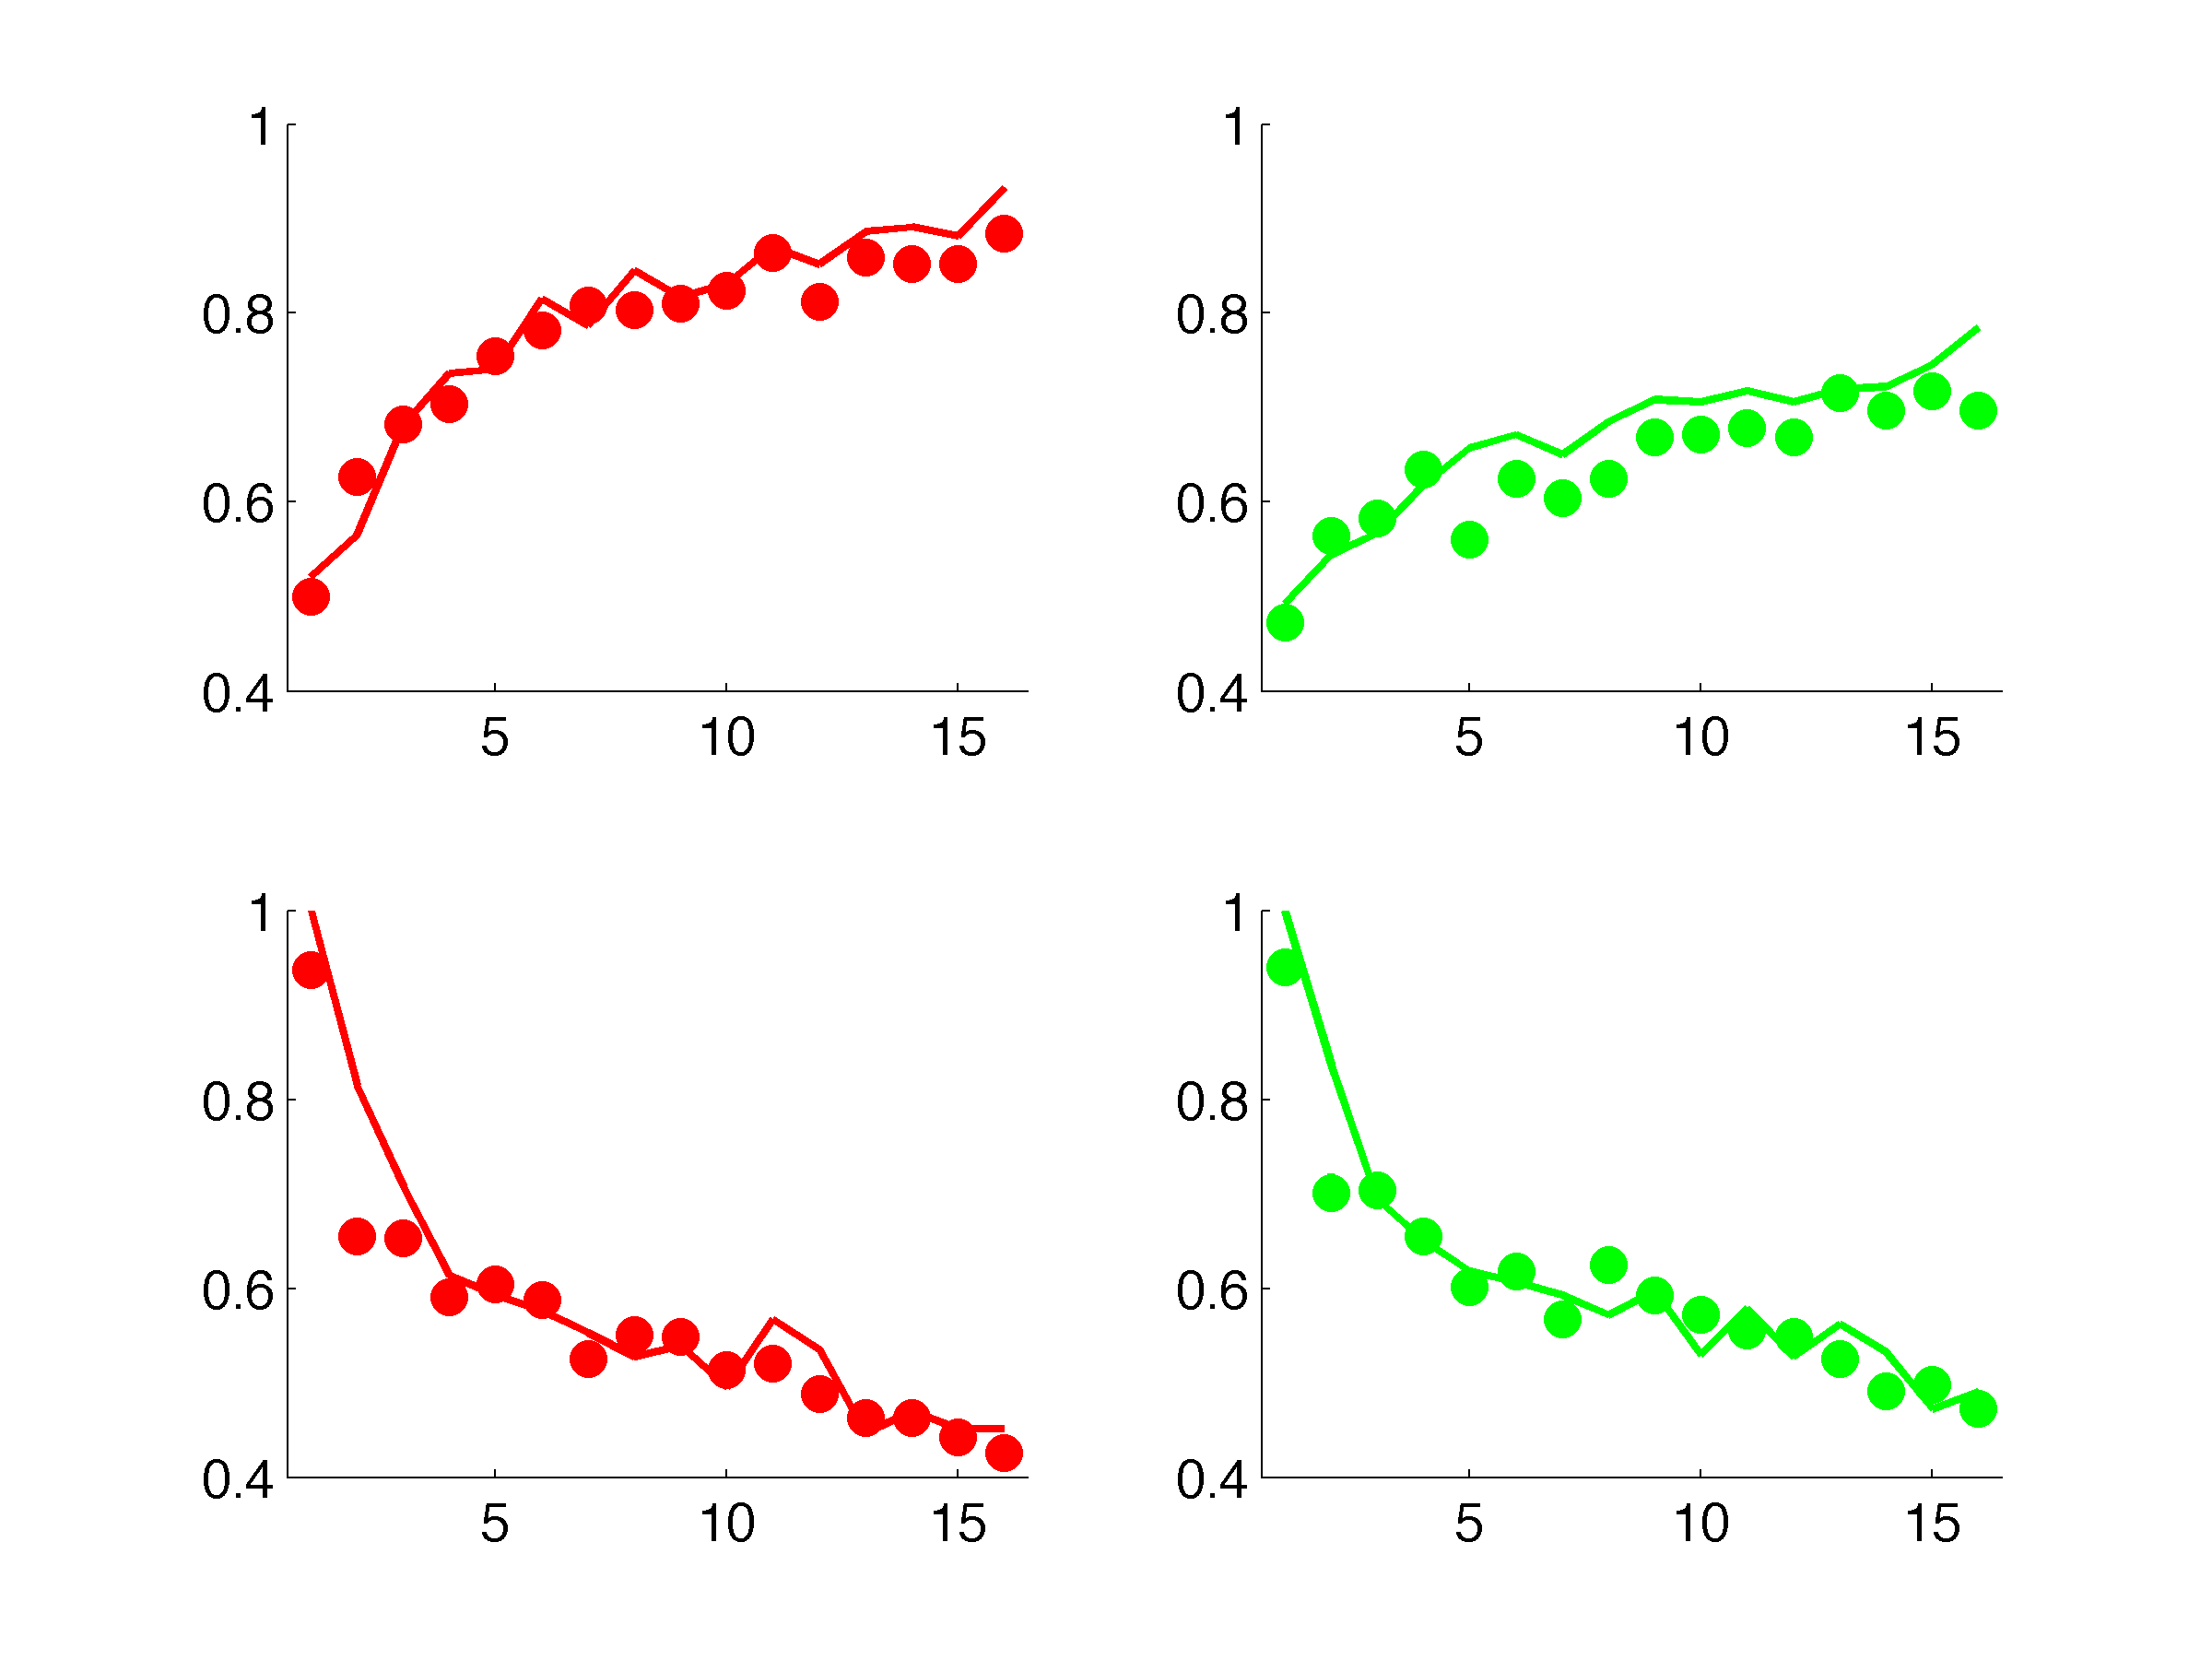
A
B
familiar cues
novel cues
% accuracy
% choose target
trial
trial

Slide 2
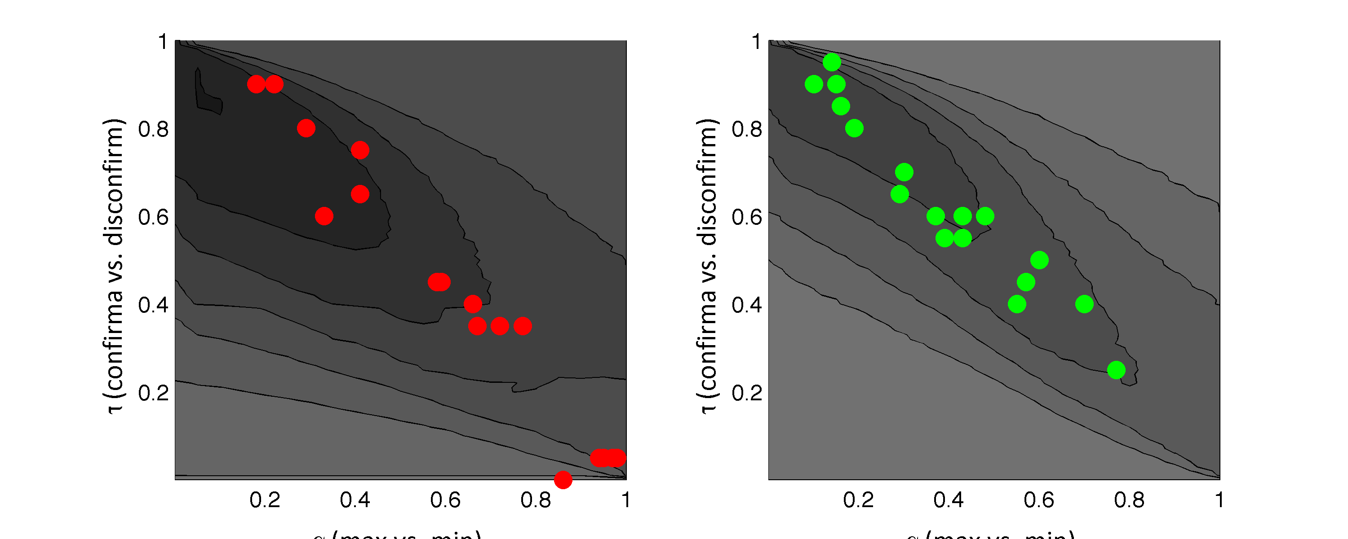
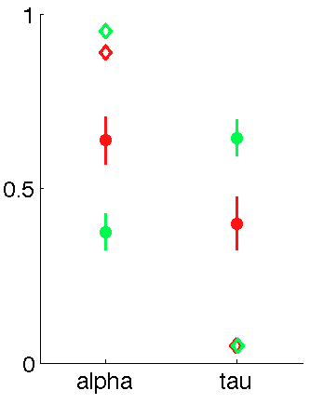
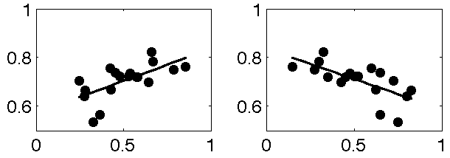
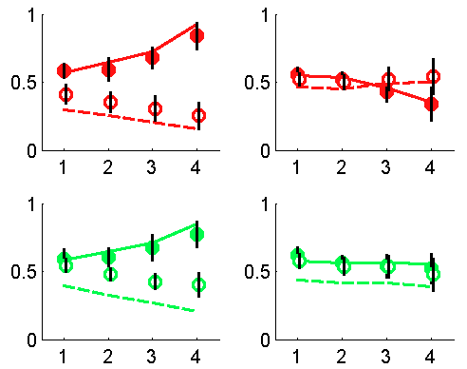
A
B
familar
novel
α (disconfirm[1] vs.
confirm [0])
learning from
disconfirmatoin
decisions based on max
τ (min [1] vs. max [0])
τ (min [1] vs. max [0])
familiar (fit)
novel (fit)
C
novel
familiar (rmax)
novel (rmax)
% accuracy
learning (α)
policy (τ)
D
familiar (relevant)
novel (relevant)
p(target)
familiar (irrelevant)
novel (irrelevant)
p(target)
n (previous)
n (previous)

Slide 3
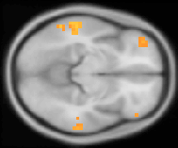

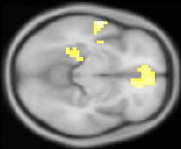
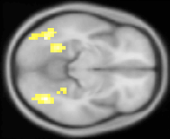
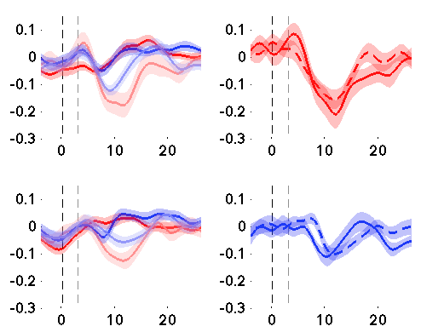
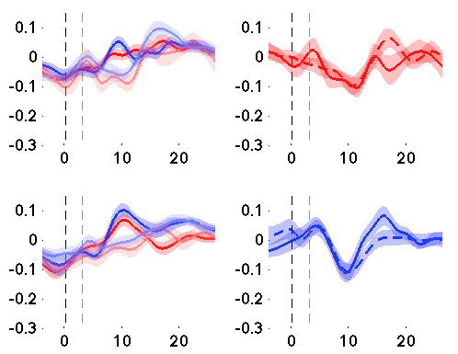


A
EV (VF model)
EV (CI model)
EV (HB model)
5
4
3
2
y=0
1
B
VMPFC
putamen
HRF (parameter estimate)
time (seconds poststimulus)

Slide 4
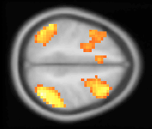
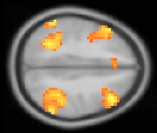
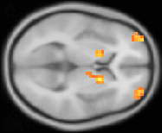
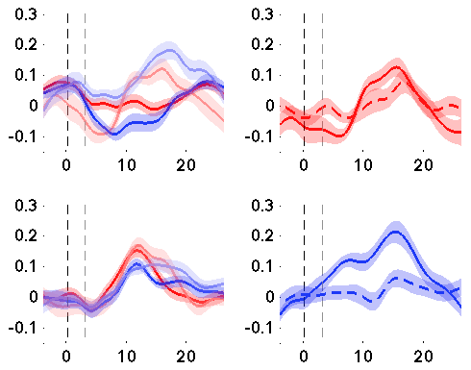
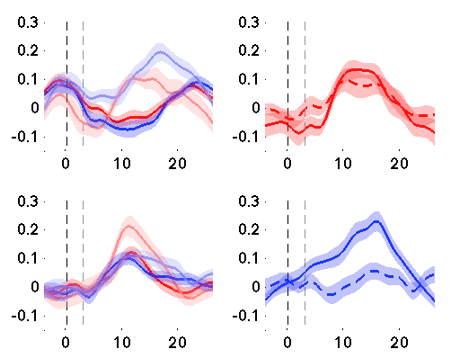
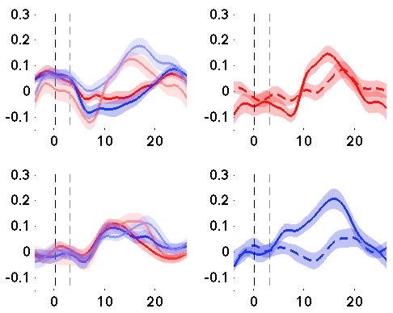

A
IPL, z = 48
DLPFC, z = 38
RLPFC, z = 2
p < 0.001, uncorrected
B
HRF (familiar)
HRF (novel)
C
IPL, z = 46
HRF (parameter estimate)
time (seconds poststimulus)

Slide 5
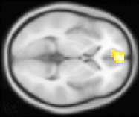
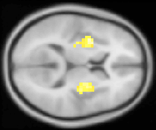
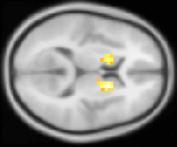
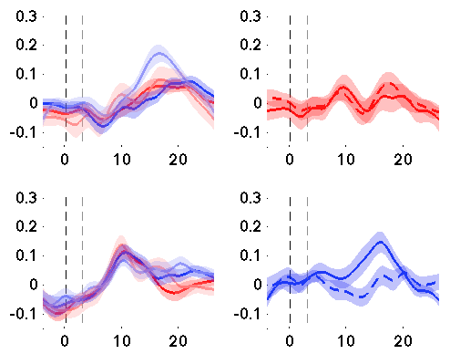
A
VMPFC, z = 0
putamen, z = 10
caudate, z = 10
B
VMPFC
putamen
caudate
HRF (parameter estimate)
time (seconds poststimulus)

Slide 6
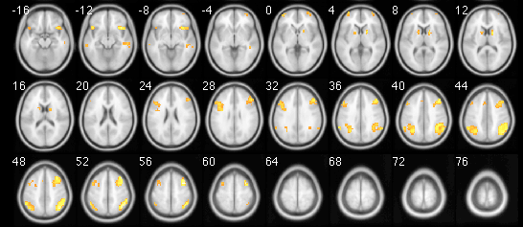
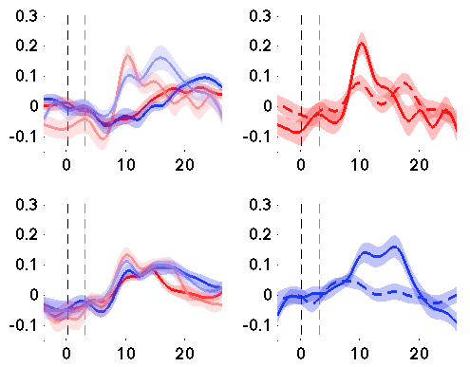
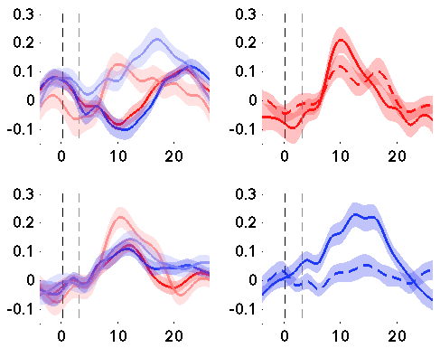
A
2
1
B
Anterior Cingulate Cortex (1)
C
Anterior Insular Cortex (2)
HRF (familiar cues)
HRF (novel cues)
time (seconds poststimulus)
time (seconds poststimulus)

Slide 7
A
DLPFC
caudate
VMPFC
putamen
HRF (parameter estimate)
time (seconds poststimulus)

